Slide 1


Wedding Planner
Let’s get married

Slide 2
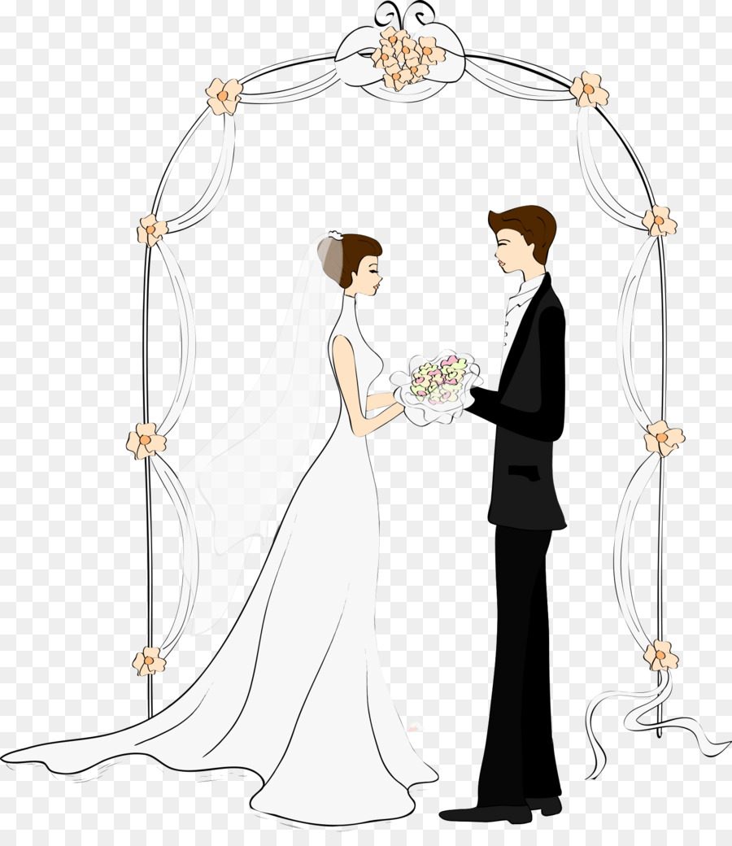


Wedding Planner
A
Introduction
Components
Wedding Packages
Project Details

Slide 3
Introduction
At Wedding Planner, our mission is to transform your wedding dreams into an extraordinary reality.
"We do more than just plan weddings :- we tell stories, create unforgettable moments, and protect your special love story.
Our goal is simple but meaningful:- To create a wedding experience that mirrors your uniqueness, celebrates your love, and goes beyond all your expectations."

Slide 4
Project concept and alignment with Sustainable Development Goals
This Wedding Planner is a software solution designed to streamline wedding planning while directly contributing to decent work and economic growth. Our platform connects users with local service providers such as caterers, decorators, photographers, musicians and event staff—creating structured, reliable job opportunities in a largely informal sector. Unlike traditional wedding apps focused only on the client, this software actively supports the workforce behind the events, making weddings a channel for sustainable development. It helps transition informal work into formal, fair and productive employment, exactly as envisioned by SDG 8.
Our software introduces professionalism and stability to the gig-based event industry by: Allowing vendors to register and showcase their services Offering a standardized pricing system to ensure fair wages Providing digital contracts and payment tracking for job security Enabling reviews and ratings to build trustworthy reputations

Slide 5
Requirements gathering process and key insights
In requirement gathering, we created google forms and circulated among potential users in order to understand user needs, preferences, and pain points in planning weddings.
Key Insights:
Most of the users wanted the app to view and manage bookings, vendor contacts and management, upload and manage images for a booking, manage post-wedding events and information.
Biggest challenge faced by most of them were managing countless details like vendors, venues, decor and attire and coordination with them.
Prefer to use the app via laptop.

Slide 6
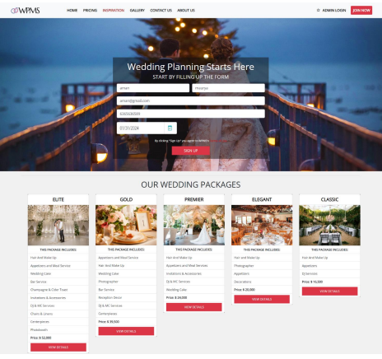
Index Page

Slide 7
Admin Login
Dashboard
Blog & Event
Clients
Services
Gallery
Upload Photo
User Management

Slide 8
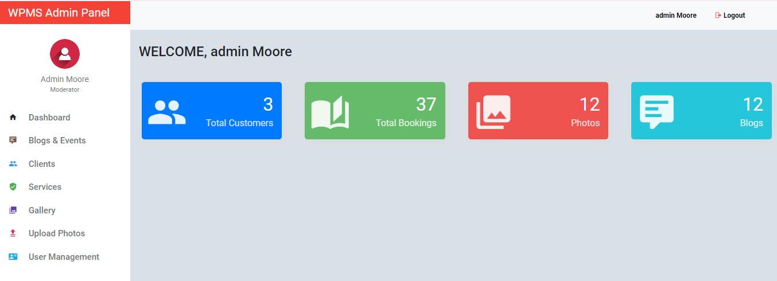
Admin Dashboard

Slide 9
Wedding Packages
Hair And Make Up
Appetizers
DJ Services
ELITE
Hair And Make Up
Appetizers and Meal Service
Wedding Cake
Photographer
Bar Service
Reception Décor
DJ & MC Services
Invitations & Accessories
Photobooth
GOLD
Appetizers and Meal Service
Hair And Make Up
Wedding Cake
Photographer
Bar Service
Reception Décor
DJ & MC Services
Invitations & Accessories
PRIMIER
Hair and Make Up
CLASSIC
ELEGANT
Photographer
Appetizers
Decorations
Hair And Make Up
Appetizers and Meal Services
Invitations & Accessories
DJ & MC Services
Wedding Cake

Slide 10
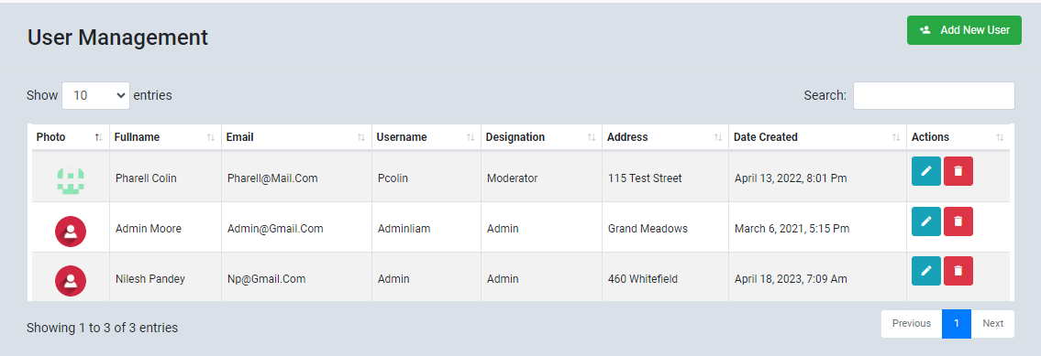
User Management

Slide 11
Testing outcomes and validation
Defect Detection
During testing, we identified major and minor defects and reported them to the development team.
Requirement Coverage
All requirements were tested against designed test cases.
“Around 95% of functional requirements were successfully tested and passed.”
Quality Improvement
The outcome of testing was that the application’s reliability, performance, and usability were verified.

Slide 12
Individual contributions and learning reflections
Amit Prakash Yadav – Programmer, Technical analyst
Afrin R – Tester
Tesmia Siby – PM, User researcher
Learning reflections:
Importance of understanding diverse user needs
Collaboration is crucial
Budget management is a priority
Security and privacy plays a vital pole
Importance of scalability and future features

Slide 13
Project Details
Project Name :- Wedding Planner
UI Technologies :- HTML , CSS , JavaScript
JEE Technologies :- Servlet & JSP
Database :- MySQL
Framework :- Hibernate

Slide 14
Thank you
Names of members
Amit Prakash Yadav

